Slide 1

ETFLIX
Sibila Ali

Slide 2
CONTENTS
DATA COLLECTION
DATA WRANGLING
DATA EXPLORATION
ANOVAS

Slide 3
NETFLIX TV SHOWS AND MOVIES (2022 UPDATED)
RUNNING DATA ANALYSIS OF RAW_TITLES NETFLIX DATA SET TO SEE IF THERE IS A CORRELATION BETWEEN TV SHOW RATING(AGE CERTIFICATION) AND IMDB SCORE

Slide 4
METHODS OF DATA COLLECTION
THIS IS A CSV FILE ORIGINALLY DOWNLOADED FROM KAGGLE
IMPORTED INTO WORKINGS USING PANDAS LIBRARY

Slide 5
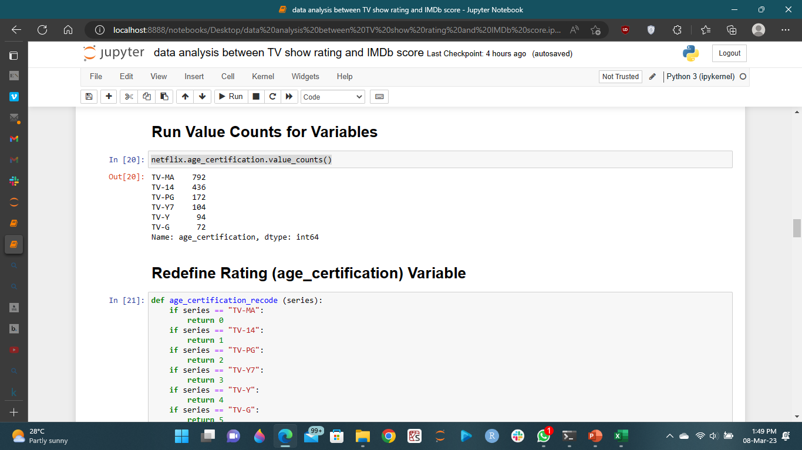
DATA WRANGLING
THE ORIGINAL DATA SET HAD 5806 ROWS
THE DATA SET INCLUDED BOTH MOVIES AND TV SHOWS
THE MOVIES AND TV SHOWS CONTAINED WERE RELEASED FROM THE YEAR 1945 TO 2022
A SUBSET OF TV SHOWS ONLY WAS USED IN THE ANALYSIS
THE SAMPLE SIZE FOR EACH RATING WAS DIFFERENT

Slide 6
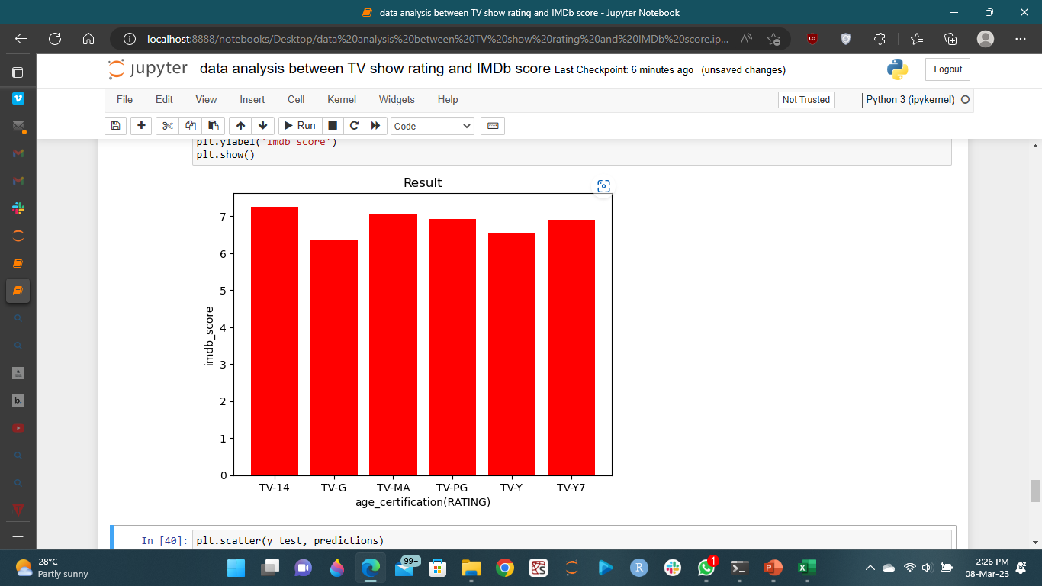
DATA EXPLORATION TV SHOW IMDB SCORE PER RATING

Slide 7
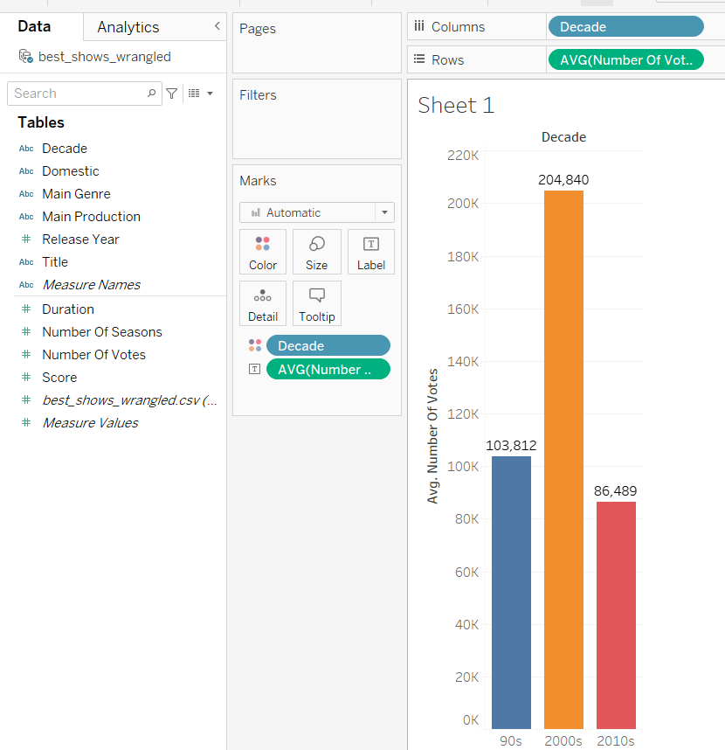
DATA VISUALIZATION
Average number of votes by decade

Slide 8
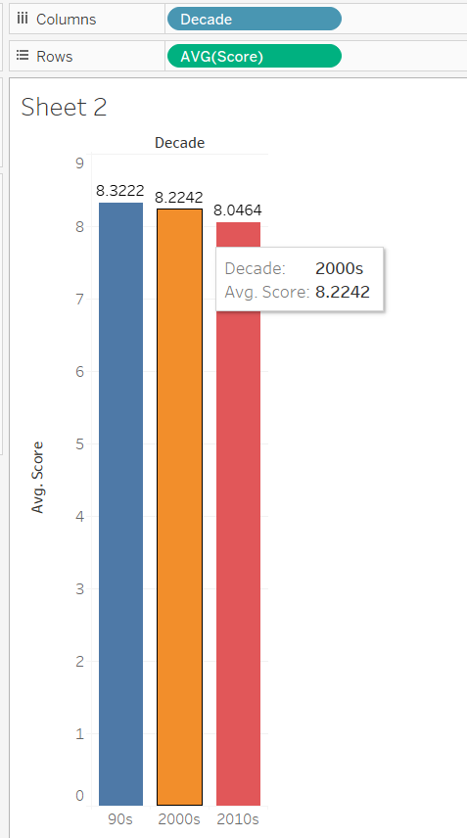
Average score of Netflix show by decade

Slide 9
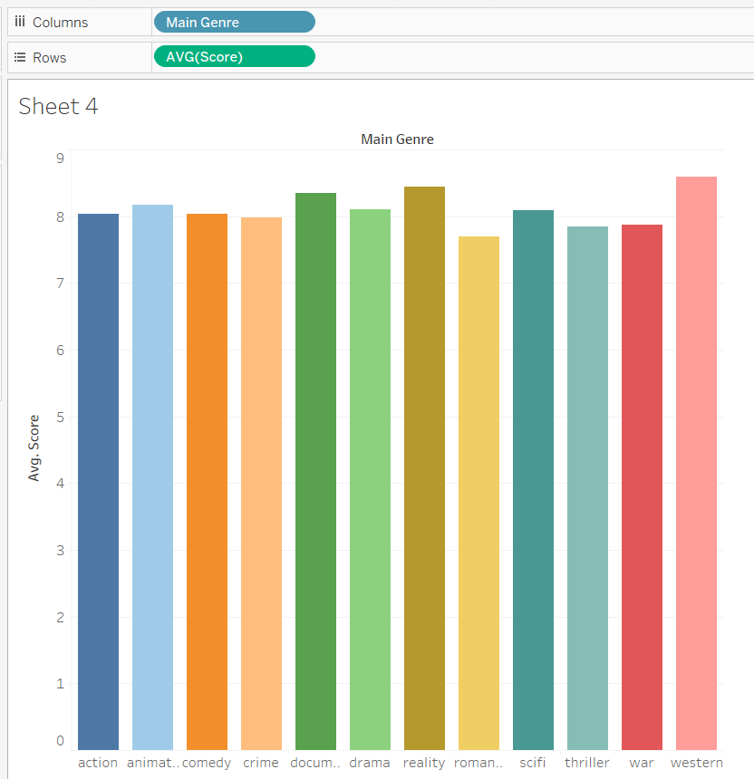
Average score by genre

Slide 10
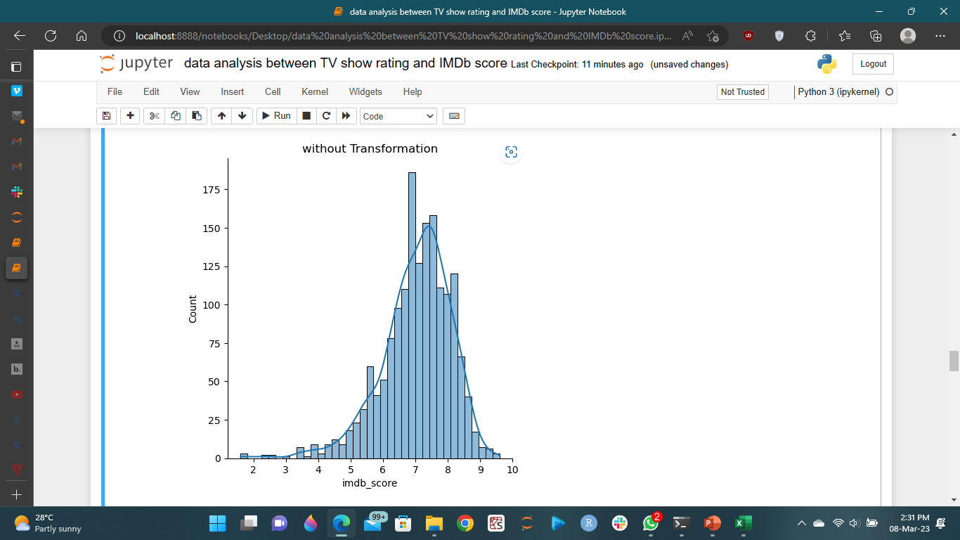
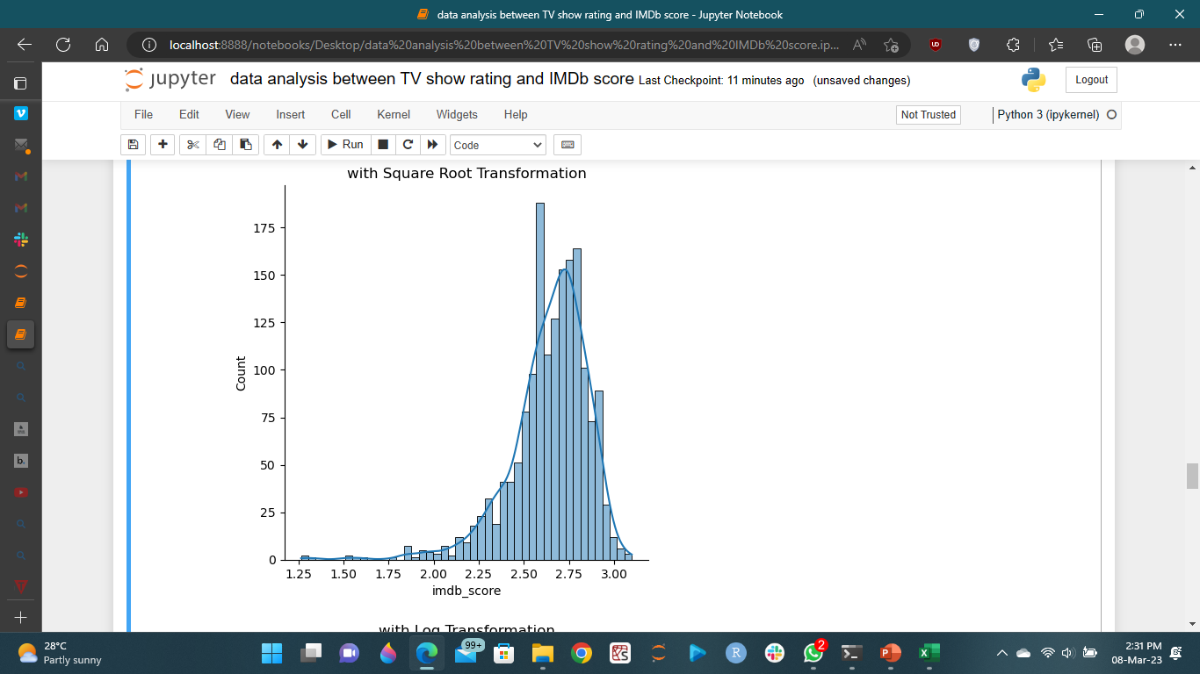
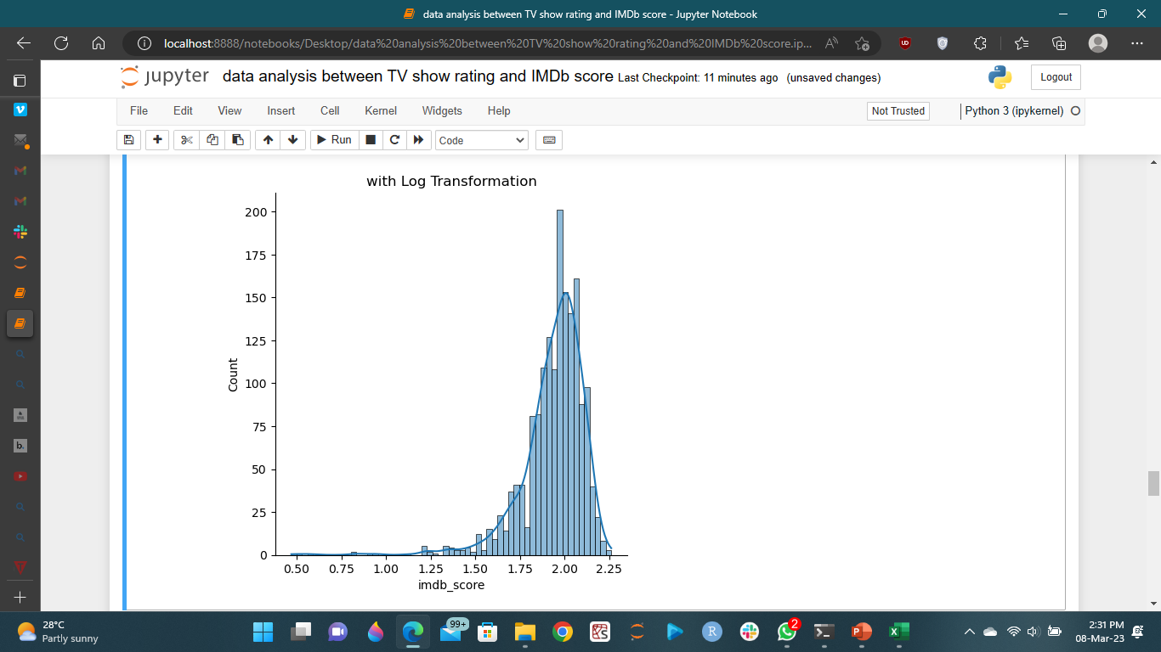
ANOVA
Both curves look normal and there was no change even with transformation
We can use any of the analysis without transformation

Slide 11
ANOVA RESULT
ANOVA RESULT WAS SIGNIFICANT SERVING AS EVIDENCE THAT THERE WAS A DIFFERENCE BETWEEN THE IMDB_SCORES OF THE DIFFERENT TV SHOWS RATING(AGE_CERTIFICATION)
THE TV SHOW WITH AGE_CERTIFIFCATION TV-14 HAS THE HIGHEST IMDB_SCORE OF 7.262615 WHILE TV-G HAS THE LEAST IMDB_SCORE OF 6.348611

Slide 12
Anova result cont’d
A BARTLETT TEST WAS USED AND CONCLUSION MET.
THE NULL HYPOTHESIS FOR THESE IS THAT THE DATA HAS EQUAL VARIANCE
HOWEVER, THE P-VALUE IS <0.05, MEANING WE'VE VIOLATED THE ASSUMPTION OF HOMOGENITY OF VARIANCE

Slide 13
QUESTIONS?

Slide 14
Thank you

